Slide 1


Department of Electronics and Communication Engineering
VLSI Design
COURSE CODE
Topic:
Second order effects
Session - 8

Slide 2



AIM OF THE SESSION
To familiarize students with aspects the Second Order Effects.
INSTRUCTIONAL OBJECTIVES
This Session is designed to:
Discuss the second order effect.
Describe the second order effect on device performance.
LEARNING OUTCOMES
At the end of this session, you should be able to:
Discuss the second order effect.
Describe the second order effect on device performance.
Summarize the second order effect.

Slide 3

Second Order Effects
Following are the list of second order effects of MOSFET.
Threshold voltage – Body effect
Subthreshold region
Channel length modulation
Mobility variation
Fowler_Nordheim Tunneling
Drain Punch through
Impact Ionization – Hot Electrons

Slide 4

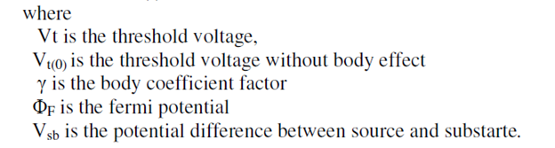
Second Order Effects
Threshold Voltage
The change in the threshold voltage of a MOSFET, because of the voltage difference between body and source is called body effect.
The expression for the threshold voltage is given by the following expression.
If Vsb is zero, then Vt=Vt(0) that means the value of the threshold voltage will not be changed.
Therefore, we short circuit the source and substrate so that, Vsb will be zero.

Slide 5
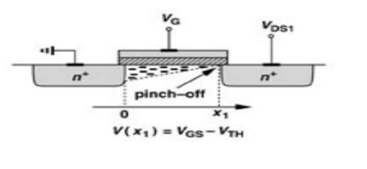
Second Order Effects
Threshold Voltage
Subthreshold region: For Vgs<Vt also we will get some value of Drain current this is called as Subthreshold current, and the region is called as Subthreshold region.
We have assumed that the device turns off abruptly as VGS drop below VTH.
In reality, for VGS ≈ VTH, a “weak” inversion layer still exists and some current flow from D to S.
Even for VGS < VTH, ID is finite, but it exhibits an exponential dependence on VGS. This is called “subthreshold conduction ” Or
For Vgs<Vt also we will get some value of Drain current this is called as Subthreshold current, and the region is called as Subthreshold region.

Slide 6
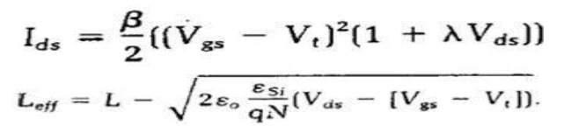
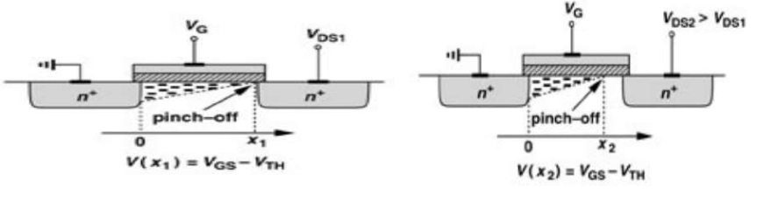
Second Order Effects
Channel Length Modulation
The channel length of the MOSFET is changed due to the change in the drain to source voltage.
This effect is called as the channel length modulation.
The channel length of the MOSFET is changed due to the change in the drain to source voltage.
This effect is called as the channel length modulation.
➢ The effective channel length & the value of the drain current considering channel length modulation into effect is given by
Where λ is the channel length modulation factor.

Slide 7
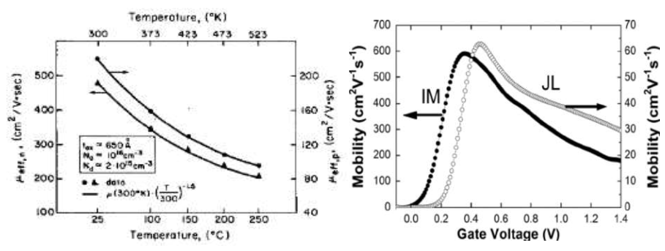
Second Order Effects
Mobility Variation
Mobility is the defined as the ease with which the charge carriers drift in the substrate material.
Mobility decreases with increase in doping concentration and increase in temperature. Mobility is the ratio of average carrier drift velocity and electric field. Ø Mobility is represented by the symbol μ

Slide 8

Second Order Effects
Fowler-Nordheim Tunnelling
When the gate oxide is very thin a current can flow from gate to source or drain by electron tunnelling through the gate. This called Fowler‐Nordheim tunnelling.
OR
When the gate oxide is very thin there can be a current between gate and source or drain by electron tunneling through the gate oxide.
➢ This current is proportional to the area of the gate of the transistor.

Slide 9
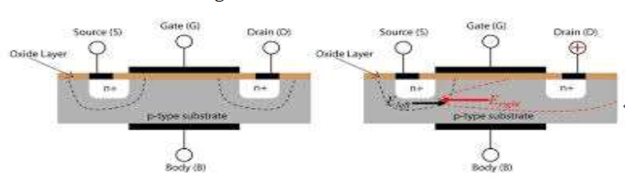
Second Order Effects
Drain Punch through
When the drain voltage is very high w.r.t source, depletion region around drain may extend to the source causing current to flow irrespective of the gate voltage (even if it is zero).
OR
When the drain is a high voltage, the depletion region around the drain may extend to the source, causing the current to flow even it gate voltage is zero.
➢ This is known Punch through condition.

Slide 10
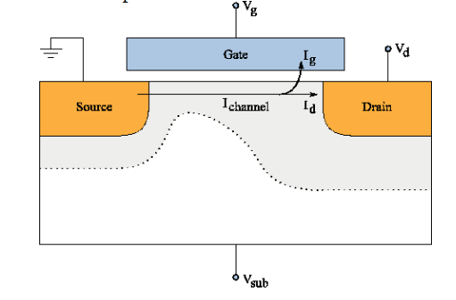
Second Order Effects
Impact Ionization -- hot Electrons
When the length of the transistor is reduced, the electric field at the drain increases.
Ø The field can become so high that electrons are imparted with enough energy we can term them as hot.
Ø These hot electrons impact the drain, dislodging holes that are then swept toward the negatively charged substrate and appear as a substrate current.
Ø This effect is known as Impact Ionization

Slide 11
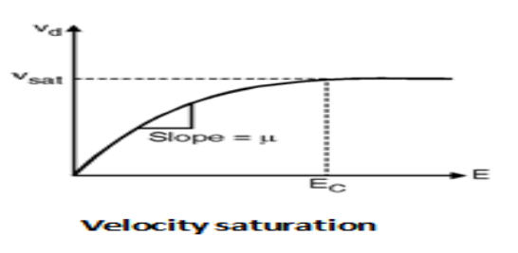
Second Order Effects
Velocity Saturation
For high VDS, carriers experience higher lateral electric fields.
➢ Carrier velocity increases with increasing lateral electric fields.
➢ However, once the critical lateral electric field is reached, the velocity of the carriers does not increase any further.
➢ This is caused by an increased rate of collision and carrier scattering.
➢ The current does not increase at the expected rate.
➢ Rather, the current increases very little, if at all.

Slide 12
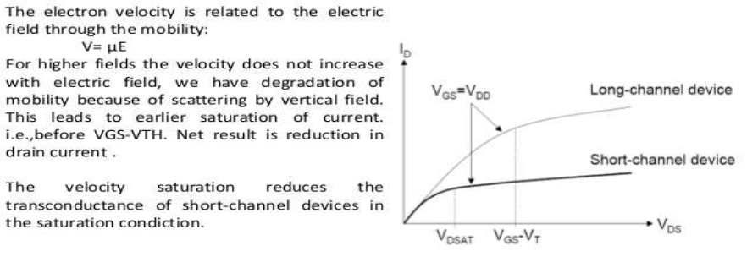
Second Order Effects
Velocity Saturation

Slide 13
Second Order Effects
Temperature Dependence
Carrier Mobility: Decreases with temperature
➢Threshold Voltage: Decreases with temperature
Junction Leakage: Increases with temperature
Velocity Saturation: Occurs sooner with higher temperature
Sub-threshold conduction: Increases exponentially with temperature. This means that at low temperatures, lower threshold voltages can be used.
Most wear out mechanisms are temperature dependent, so transistors are more reliable at lower temperatures.

Slide 14
Problem Discussion
Mention about the BICMOS Inverters and alternative BICMOS Inverters.
Determine the pull-up to pull down ratio for NMOS inverter driven by another NMOS Inverter
Draw the fabrication steps of CMOS transistor and explain its operation in detail.
Draw the fabrication steps of NMOS transistor and explain its operation in detail.

Slide 15
SELF-ASSESSMENT QUESTIONS
1. CMOS Inverter can be used as an amplifier when:
PMOS is in linear, NMOS is in cut-off.
Both are in linear region
Both PMOS and NMOS are in saturation.
NMOS is in linear, PMOS is in cut-off.
Which of the following characteristics does an active loaded MOS differential circuit possess?
High CMRR.
Low CMRR.
High Delay.
High Differential Gain.

Slide 16
REFERENCES FOR FURTHER LEARNING OF THE SESSION
Reference Books:
1. Sung-Mo Kong, Yusuf Leblebici, “CMOS Digital Integrated Circuits Analysis and Design” Third Edition.
2. Debaprasad Das, “CMOS DESIGN” Second Edition.

Slide 17
THANK YOU
Team – VLSI DESIGN

